Slide 1
Wireless Networks and Protocols
Physical Layer
1

Slide 2
Spread Spectrum
Spread transmission (much) wider spectrum band than needed for the intended bit rate
Reduce impact of a “bad” frequencies
» Also in military: jamming and interception becomes harder
The price is that you use more spectrum
What can be gained from this apparent waste of spectrum?
Provides a safety buffer to the receiver to overcome impact of bad channel properties
Several users can independently use the same higher bandwidth with very little interference
– Key idea: traffic of other users looks like noise
2

Slide 3
Spread Spectrum
In telecommunication, especially radio communication, spread spectrum designates techniques by which a signal (e.g., an electrical, electromagnetic, or acoustic) generated with a particular bandwidth is deliberately spread in the frequency domain, resulting in a signal with a wider bandwidth.
(Source: WIKI)

Slide 4
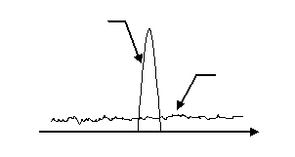
Spread Spectrum (cont.)
Spread spectrum generally makes use of a sequential noise-like signal structure to spread the normally narrowband information signal over a relatively wideband (radio) band of frequencies.
Narrowband
Signal level
Noise level
The idea behind spread spectrum is to use more bandwidth than the original message A spread spectrum signal does not have a clearly distinguishable peak in the spectrum.
This makes the signal more difficult to distinguish from noise and therefore more difficult to jam or intercept.

Slide 5
Spread Spectrum (cont.)
Spread-spectrum techniques are used for:
establishment of secure communications,
increasing resistance to natural interference, noise, and jamming,
to prevent detection, and
to enable multiple-access communications.
There are two predominant techniques to spread the spectrum:
Frequency hoping (FH), which makes the narrow band signal jump in random narrow bands within a larger bandwidth.
Direct sequence (DS) which introduces rapid phase transition to the data to make it larger in bandwidth.

Slide 6
Frequency Hopping Spread Spectrum (FHSS)
Frequency-hopping spread spectrum (FHSS) is a method of transmitting radio signals by rapidly changing the carrier frequency among many frequencies occupying a large spectral band. The changes are controlled by a code known to both transmitter and receiver.
Frequency
Time
The frequency band is divided into smaller sub-bands. Signals rapidly change ("hop") their carrier frequencies among the center frequencies of these sub-bands in a determined order. Interference at a specific frequency will affect the signal only during a short interval.

Slide 7
Example: Bluetooth
Uses frequency hopping spread spectrum in the 2.4 GHz ISM band
Uses 79 frequencies with a spacing of 1 MHz
Frequency hopping rate is 1600 hops/s
Signal uses GFSK
» Mimimum deviation is 115 KHz
Maximum data rate is 1 Mbps
Also used in the original WiFi standard
7

Slide 8
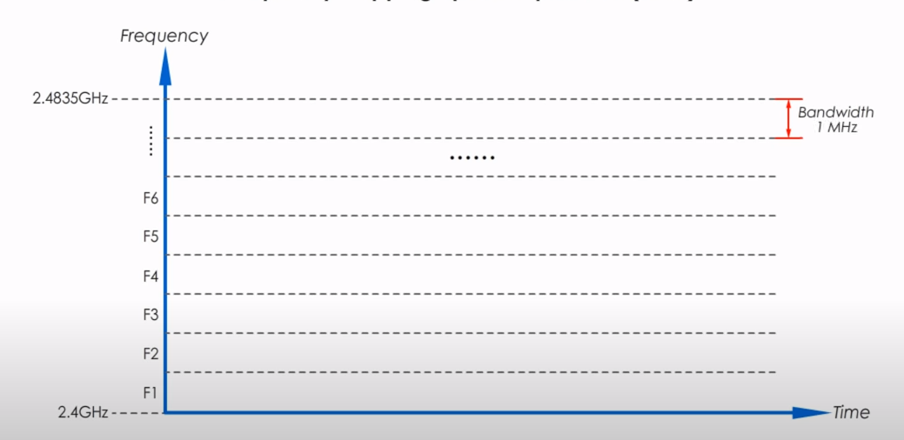
Example
Uses 79 frequencies with a spacing of 1 MHz

Slide 9
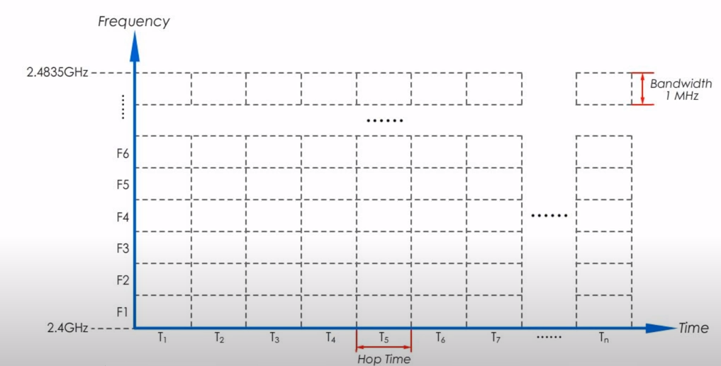
Example
Data travel time is divided into small time units, each of which is called hop time

Slide 10
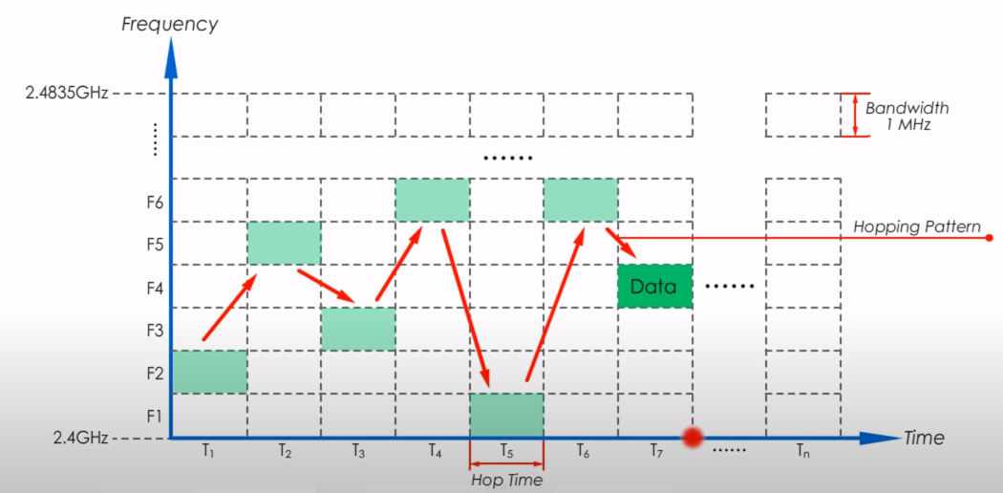
Example
From T₁ through T₇, the hopping pattern is F₂, F₅, F₃, F₆, F₁, F₆ and F₄
In Bluetooth, Frequency hopping rate is 1600 hops/s

Slide 11
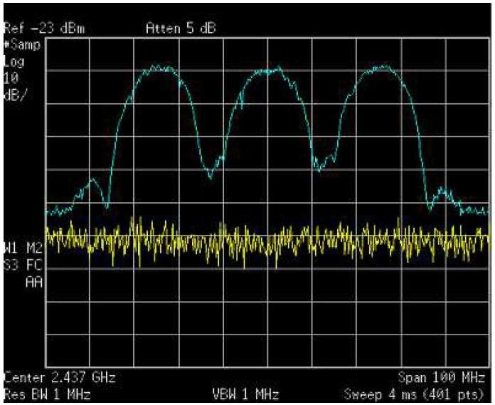
802.11 Spectrogram
11

Slide 12
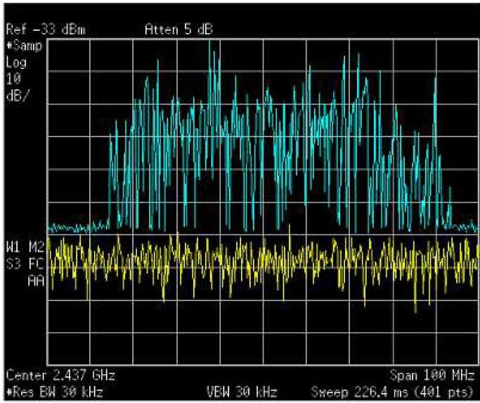
Frequency Hopping Spectrogram
12

Slide 13
FHSS Summary
FHSS sends data on one Frequency at a time and uses different frequencies over the time.
Hopping pattern is only known to sender and receiver, and different senders use different hopping patterns at different time.
FHSS is not only used by base 802.11, but also by military, cordless phones, GPS, other wireless communications.

Slide 14
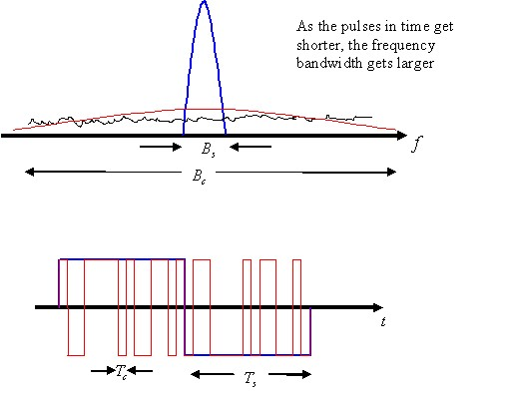
Direct Sequence Spread Spectrum (DSSS)
Direct-sequence spread spectrum (DSSS) is a spread-spectrum modulation technique primarily used to reduce overall signal interference. The direct-sequence modulation makes the transmitted signal wider in bandwidth than the information bandwidth. (Source: WiKi)
It introduces rapid phase transition to the data making it larger in bandwidth. As the period T of a signal gets shorter in time (or rate R increases), the bandwidth B of the signal increases: R = 1/T = 2B (Nyquist Rate)

Slide 15
Direct Sequence Spread Spectrum (DSSS)
Each bit in original signal is represented by multiple bits (chips) in the transmitted signal
Spreading code spreads signal across a wider frequency band
» Spread is in direct proportion to number of bits used
» E.g. exclusive-OR of the bits with the spreading code
The resulting bit stream is used to modulate the signal
Original Bit Stream |  | 1 |  |  | 1 |  |  | 0 |  |  | 1 |  |  | 0 |  |  | 0
Spreading Code | 0 | 0 | 1 | 0 | 1 | 0 | 0 | 1 | 1 | 0 | 0 | 1 | 1 | 1 | 0 | 1 | 0 | 1
XOR
Transmitted Chips
1 1 0 1 0 1 0 1 1 1 1 0 1 1 0 1 0 1
Modulated Bit Stream

Slide 16
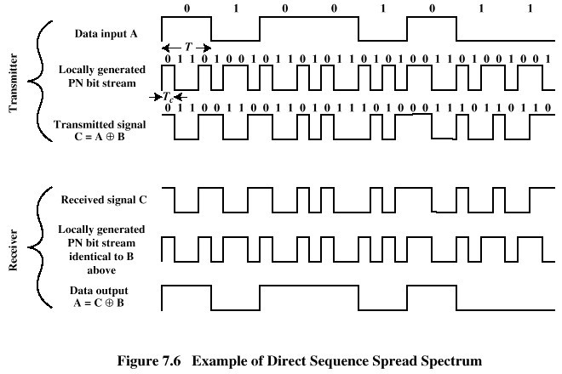
Direct Sequence Spread Spectrum (DSSS)
9
Peter A. Steenki
ste

Slide 17
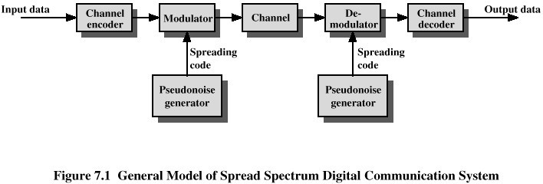
Spread Spectrum
In the Process of modulation and demodulation two goals are achieved:
Each bit is coded
Signal’s bits are distributed over a much wider frequency band
10

Slide 18
DSSS Properties
Since each bit is sent as multiple chips, you need more bps bandwidth to send the signal.
» Number of chips per bit is called the spreading ratio
Given the Nyquist and Shannon results, you need more spectral bandwidth to do this.
» Spreading the signal over the spectrum
Advantage is that is transmission is more resilient.
» Effective against noise and multi-path
» DSSS signal will look like noise in a narrow band
» Can lose some chips in a word and recover easily
Multiple users can share bandwidth (easily).
» Follows directly from Shannon (capacity is there)
» E.g., Code Division Multiple Access - next
12

